Slide 1






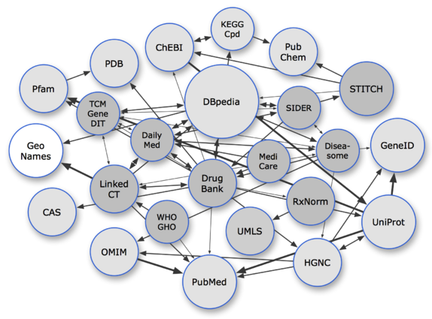
Pharmacist
5
6
4
Drug company
Patient
1
3
2
Researcher
Physician
Linked open data

